Slide 1
Development Environments
Pravin Y Pawar
From “Designing Machine Learning Systems”
By Chip Huyan

Slide 2
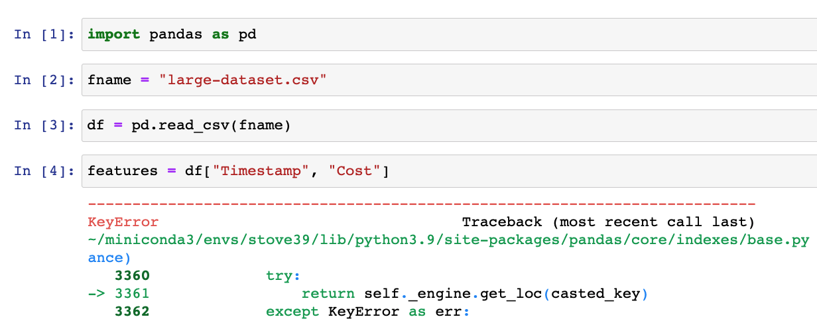
Development Environment: Notebooks
Text editors & notebooks
Where you write code, e.g. VSCode, Vim
Notebook: Jupyter notebooks, Colab
Also works with arbitrary artifacts that aren’t code (e.g. images, plots, tabular data)
Stateful
Only need to run from the failed step instead from the beginning

Slide 3
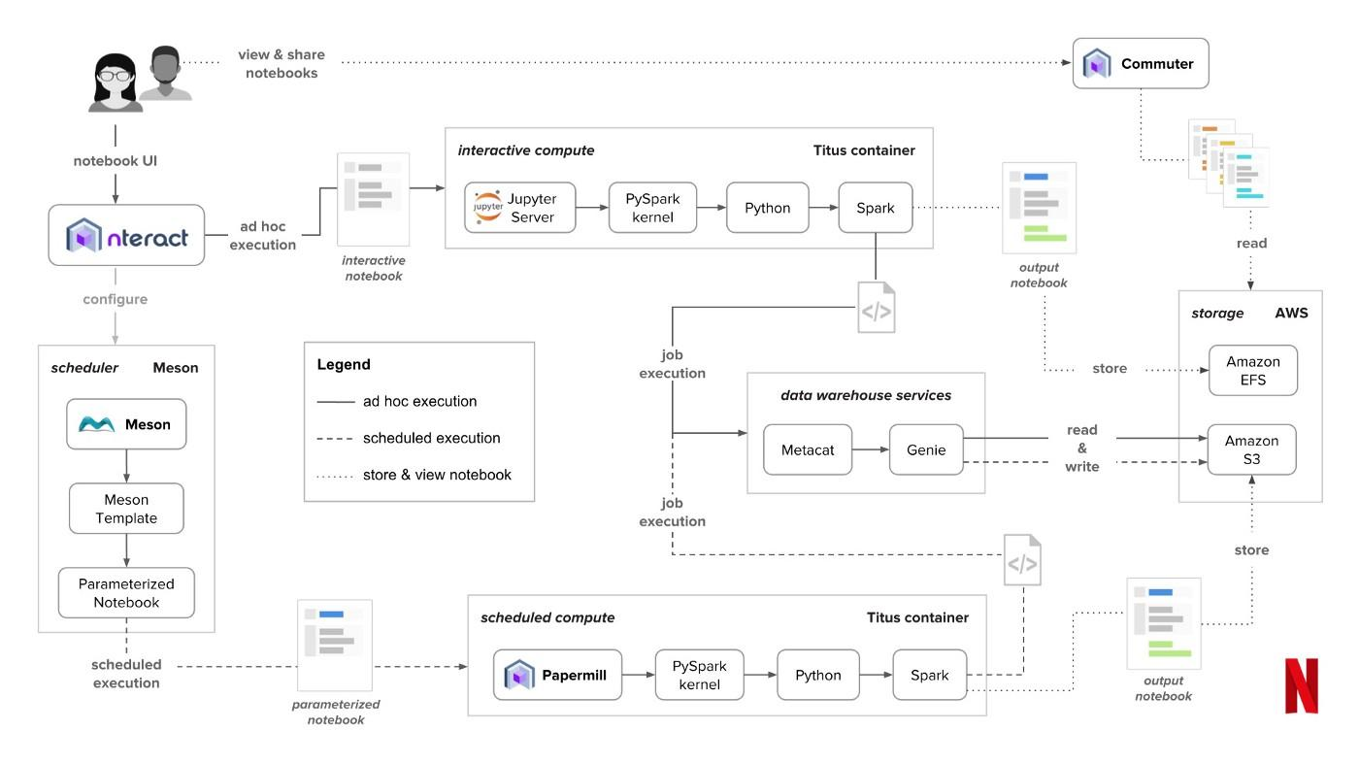
Development Environment @Netflix
Notebook at Netflix

Slide 4
Development Environment
Versioning
Git: code versioning
DVC: data versioning
WandB: experiment versioning
CI/CD test suite
test your code before pushing it to staging/prod

Slide 5
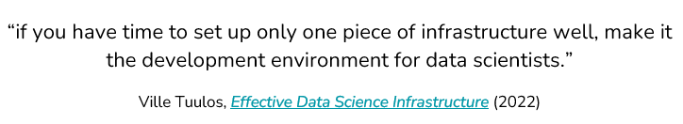
Dev env: underestimated

Slide 6
Standardize dev environments
Standardize dependencies with versions
Standardize tools & versions
Standardize hardware: cloud dev env

Slide 7
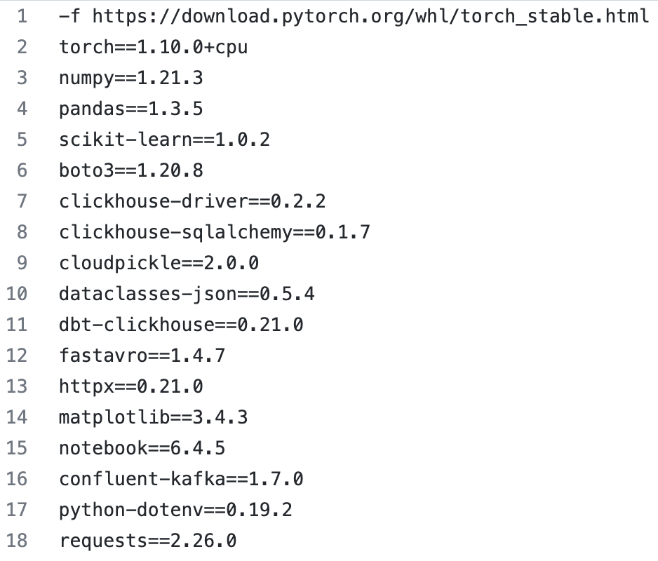
Standardize dev environments
Standardize dependencies with versions

Slide 8
Standardize dev environments
Standardize hardware: cloud dev env
Simplify IT support
Security: revoke access if laptop is stolen
Bring your dev env closer to prod env
Make debugging easier

Slide 9
Dev to prod
Elastic compute: can stop/start instances at will
How to recreate the required environment in a new instance?
Answer: Container
Step-by-step instructions on how to recreate an environment in which your model can run:
install this package
download this pretrained model
set environment variables
navigate into a folder
etc.

Slide 10

Container orchestration
Help deploy and manage containerized applications to a serverless cluster
Spinning up/down containers

Slide 11
Thank You!
In our next session:

